Slide 1

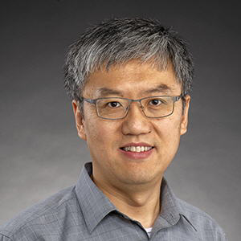

NoSQL Databases for Bioinformatics
Foundations of Not only SQL (NoSQL) Databases
Information
Services
St. Jude Children’s Research Hospital
High Performance Computing Support
Yawei Hui
Ziang Zhang
Data Bases and Data Wrangling Series. Lecture#24
Notes:
Pending refine

Slide 2
Learning Objectives
At the end of the session, you will be able to:
Explain how & why NoSQL databases emerged to address modern data challenges
Compare major NoSQL data models:
• Document (e.g. MongoDB)
• Key-Value (e.g. Redis)
• Wide-column (e.g. Cassandra)
• Graph (e.g. Neo4j)
Acknowledge the use case of NoSQL data models in bioscience

Slide 3
Before we talk about database
Opinion poll https://github.com/St-Jude-MS-ABDS/workshop-NoSQL
Notes:
Before we go to the technical terms, I would like to run a quick poll to get what's your opinions about a database

Slide 4
What have happened?
You submitted your opinions over the web
The web app remembered all submissions
The web app showed the summary to you
Notes:
Ask question: what have happened just now?
Slowly describes:
You submitted your opinions over the web
The web app remembered all submissions
The web app showed the summary to you

Slide 5
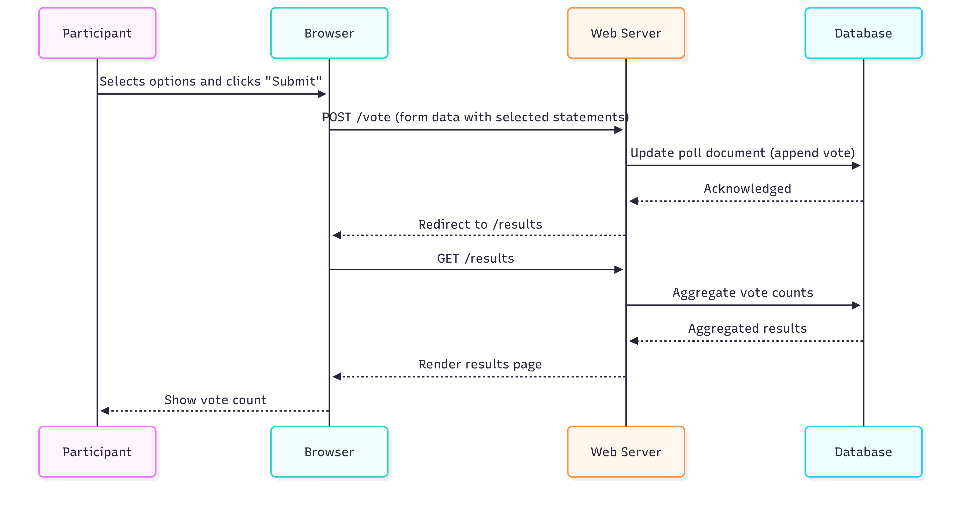
Data flow sequence
Notes:
We can further breakdown of the dataflow
The student interacts with a web form.
The browser sends the vote to your server backend.
webserver stores the vote in MongoDB.
The student is redirected to a results page that queries MongoDB for a summary.
The example will be available o the github repository. You can play with the example later. You can also design your own poll software

Slide 6
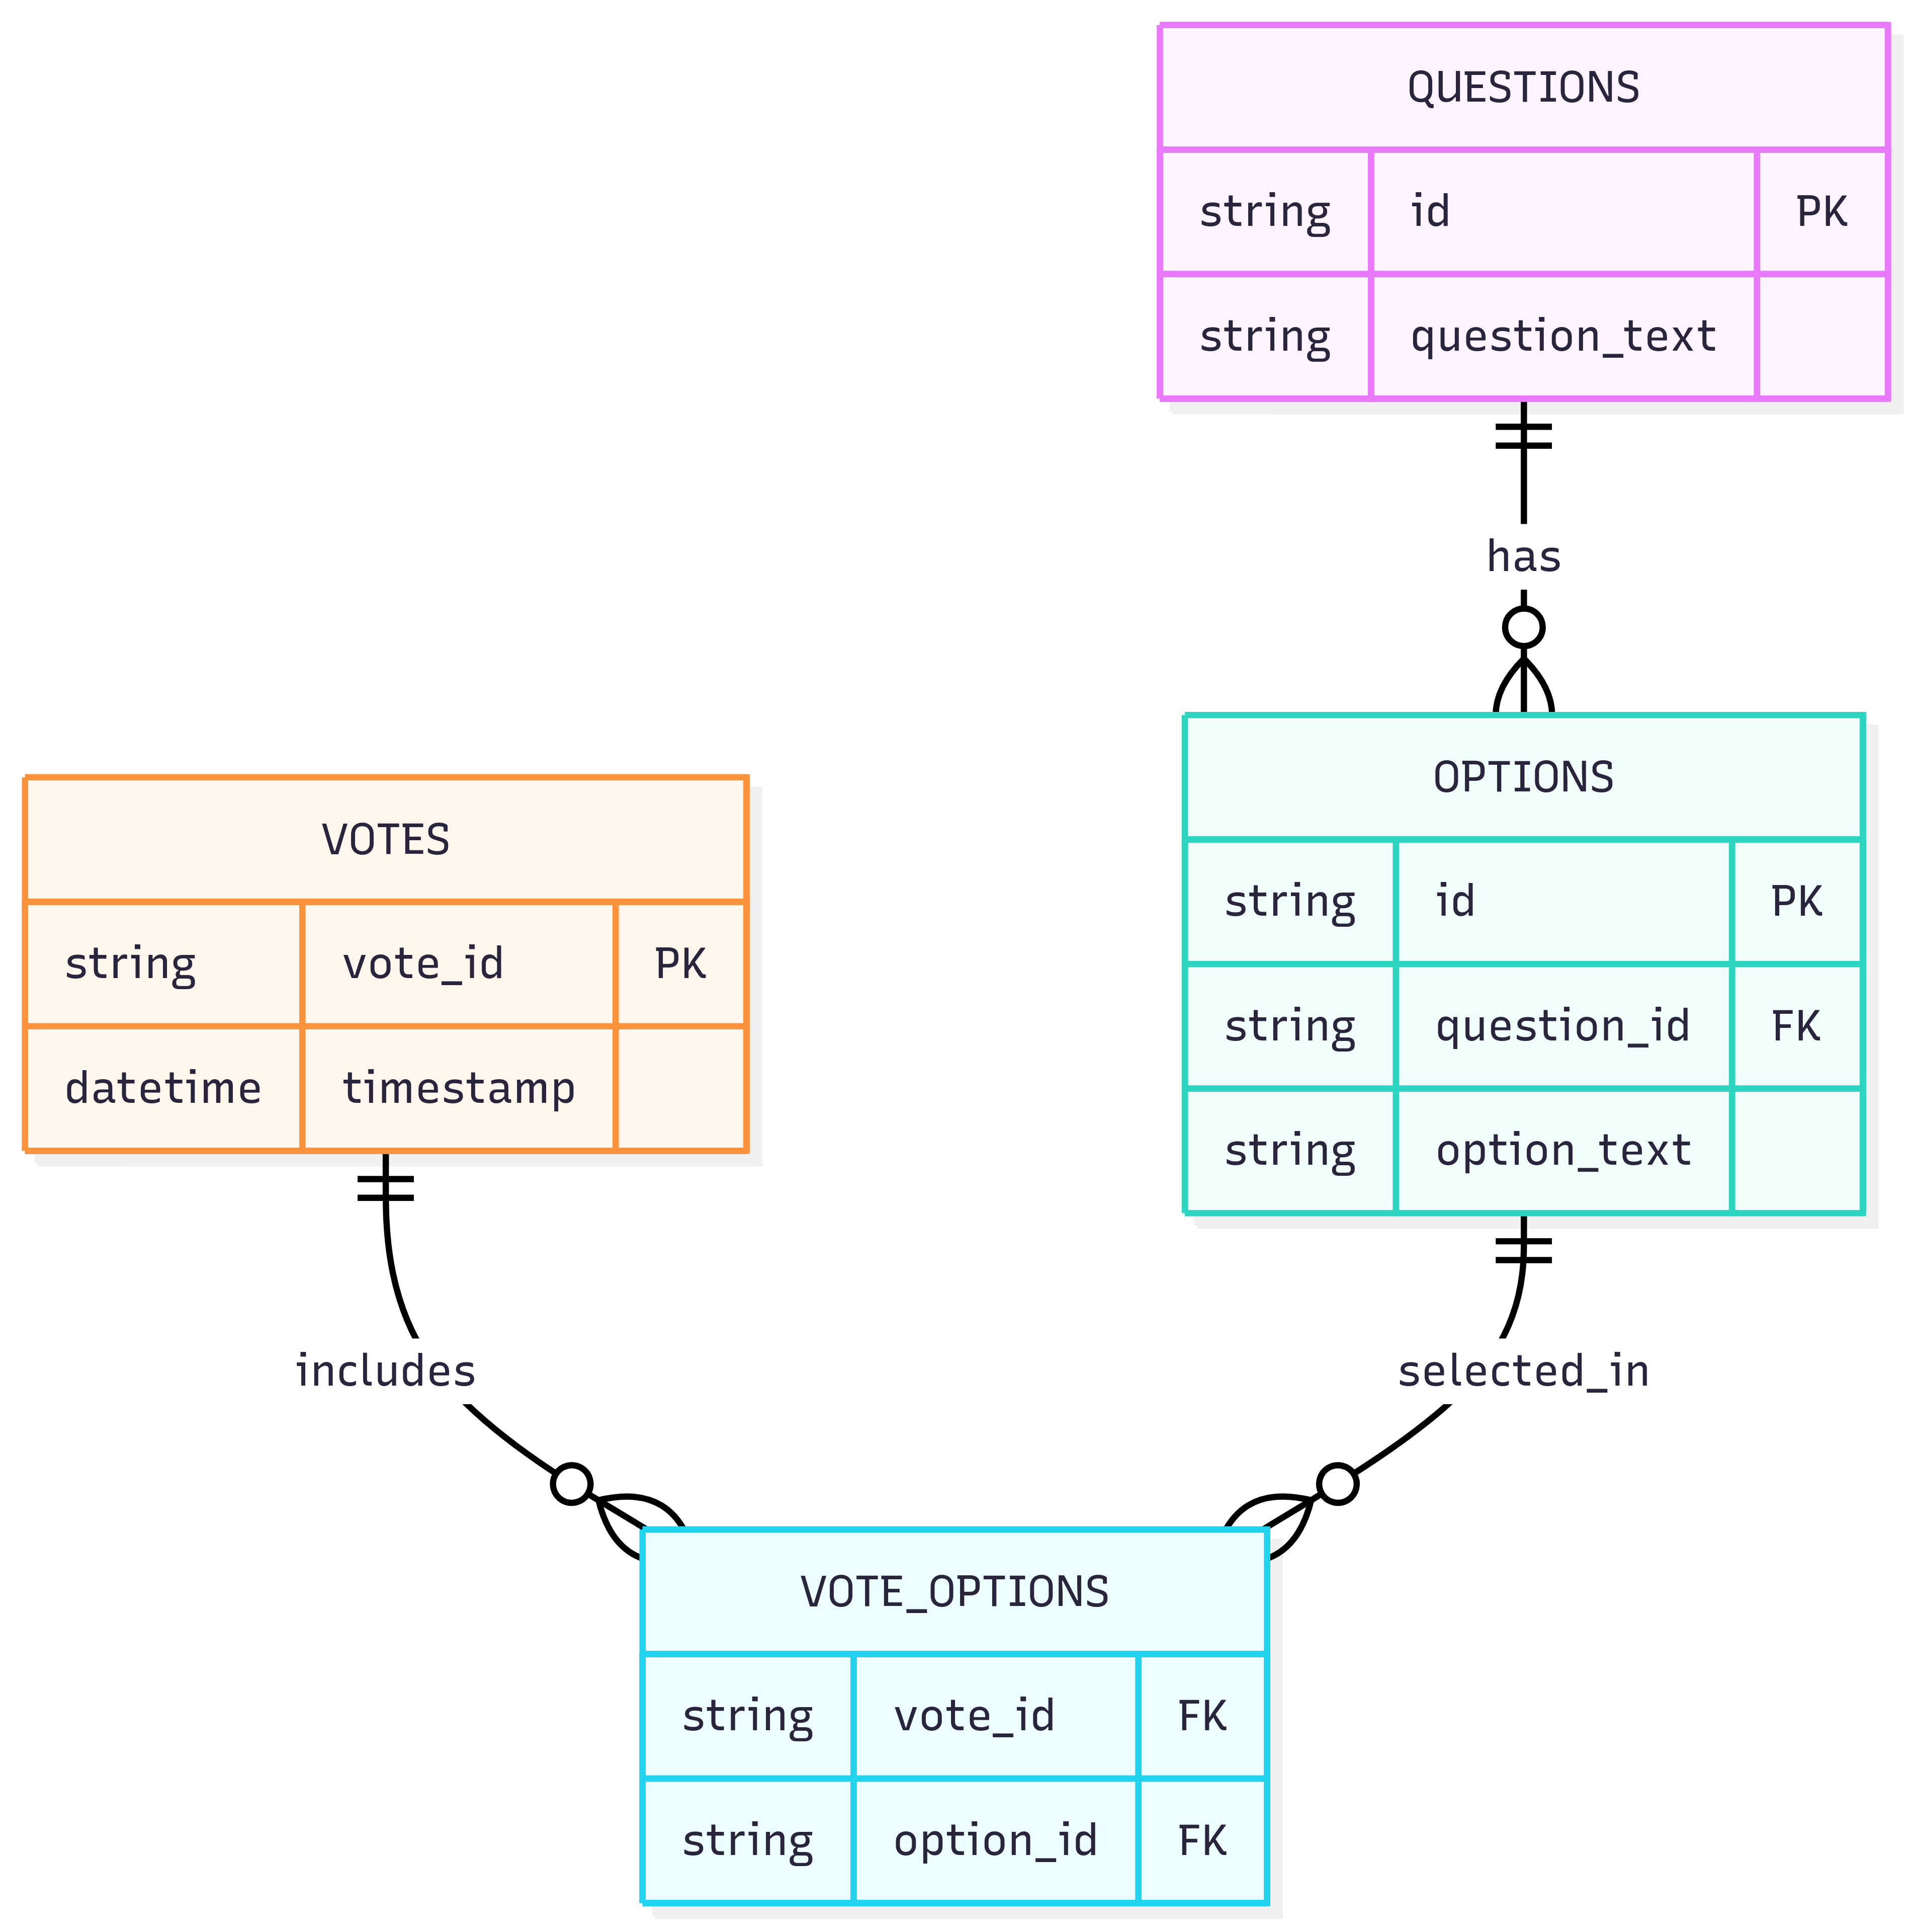
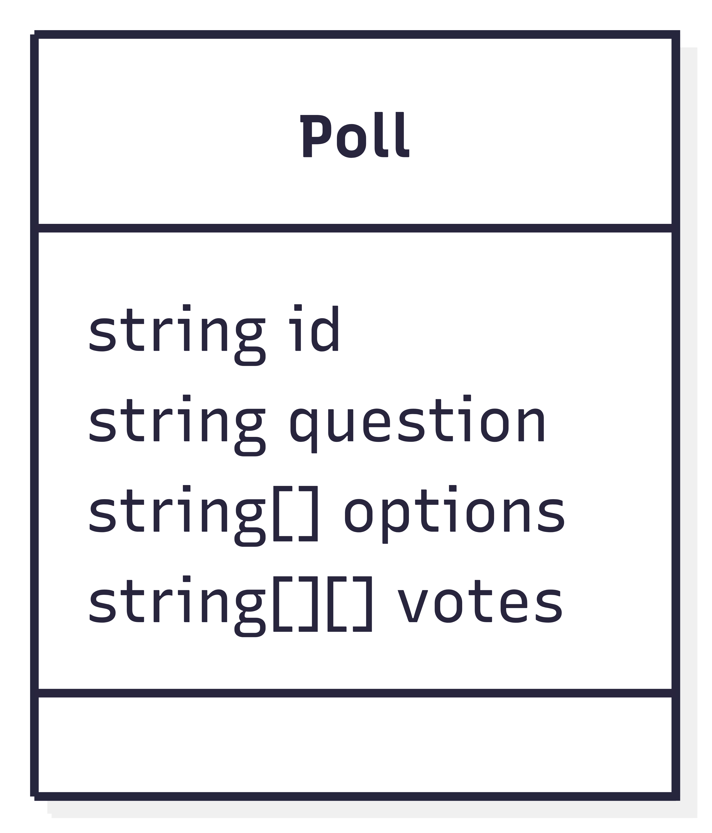
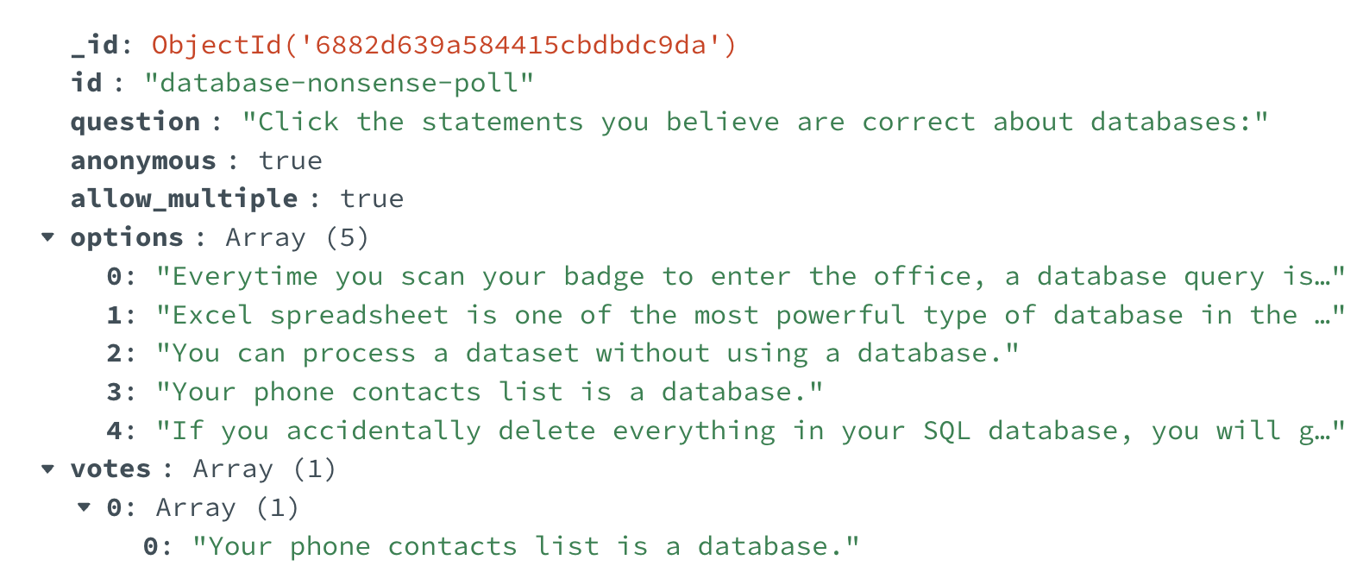
But wait — if NoSQL is so great, why did we start with SQL?
NoSQL Schema (document)
SQL schema
📦 Compact
🔀 Flexible
🧠 Intuitive
⚡ Fast Iteration
🧰 Fewer Joins
🔒 Data Integrity
📐 Structured by Design
Notes:
How to design the database scheme?
For an application with dynamic number of questions, un
We can have a quick compare. The SQL scheme is good ….
"So you’ve just interacted with a NoSQL database. It’s flexible, intuitive, and worked great for our poll...
I would like to pause and ask a question: how do you think of the No SQL:
But wait — if NoSQL is so great, why did we start with SQL?
And eve n today, why do so many businesses still rely on relational databases?"
JSON is not known to everyone
Admits to

Slide 7
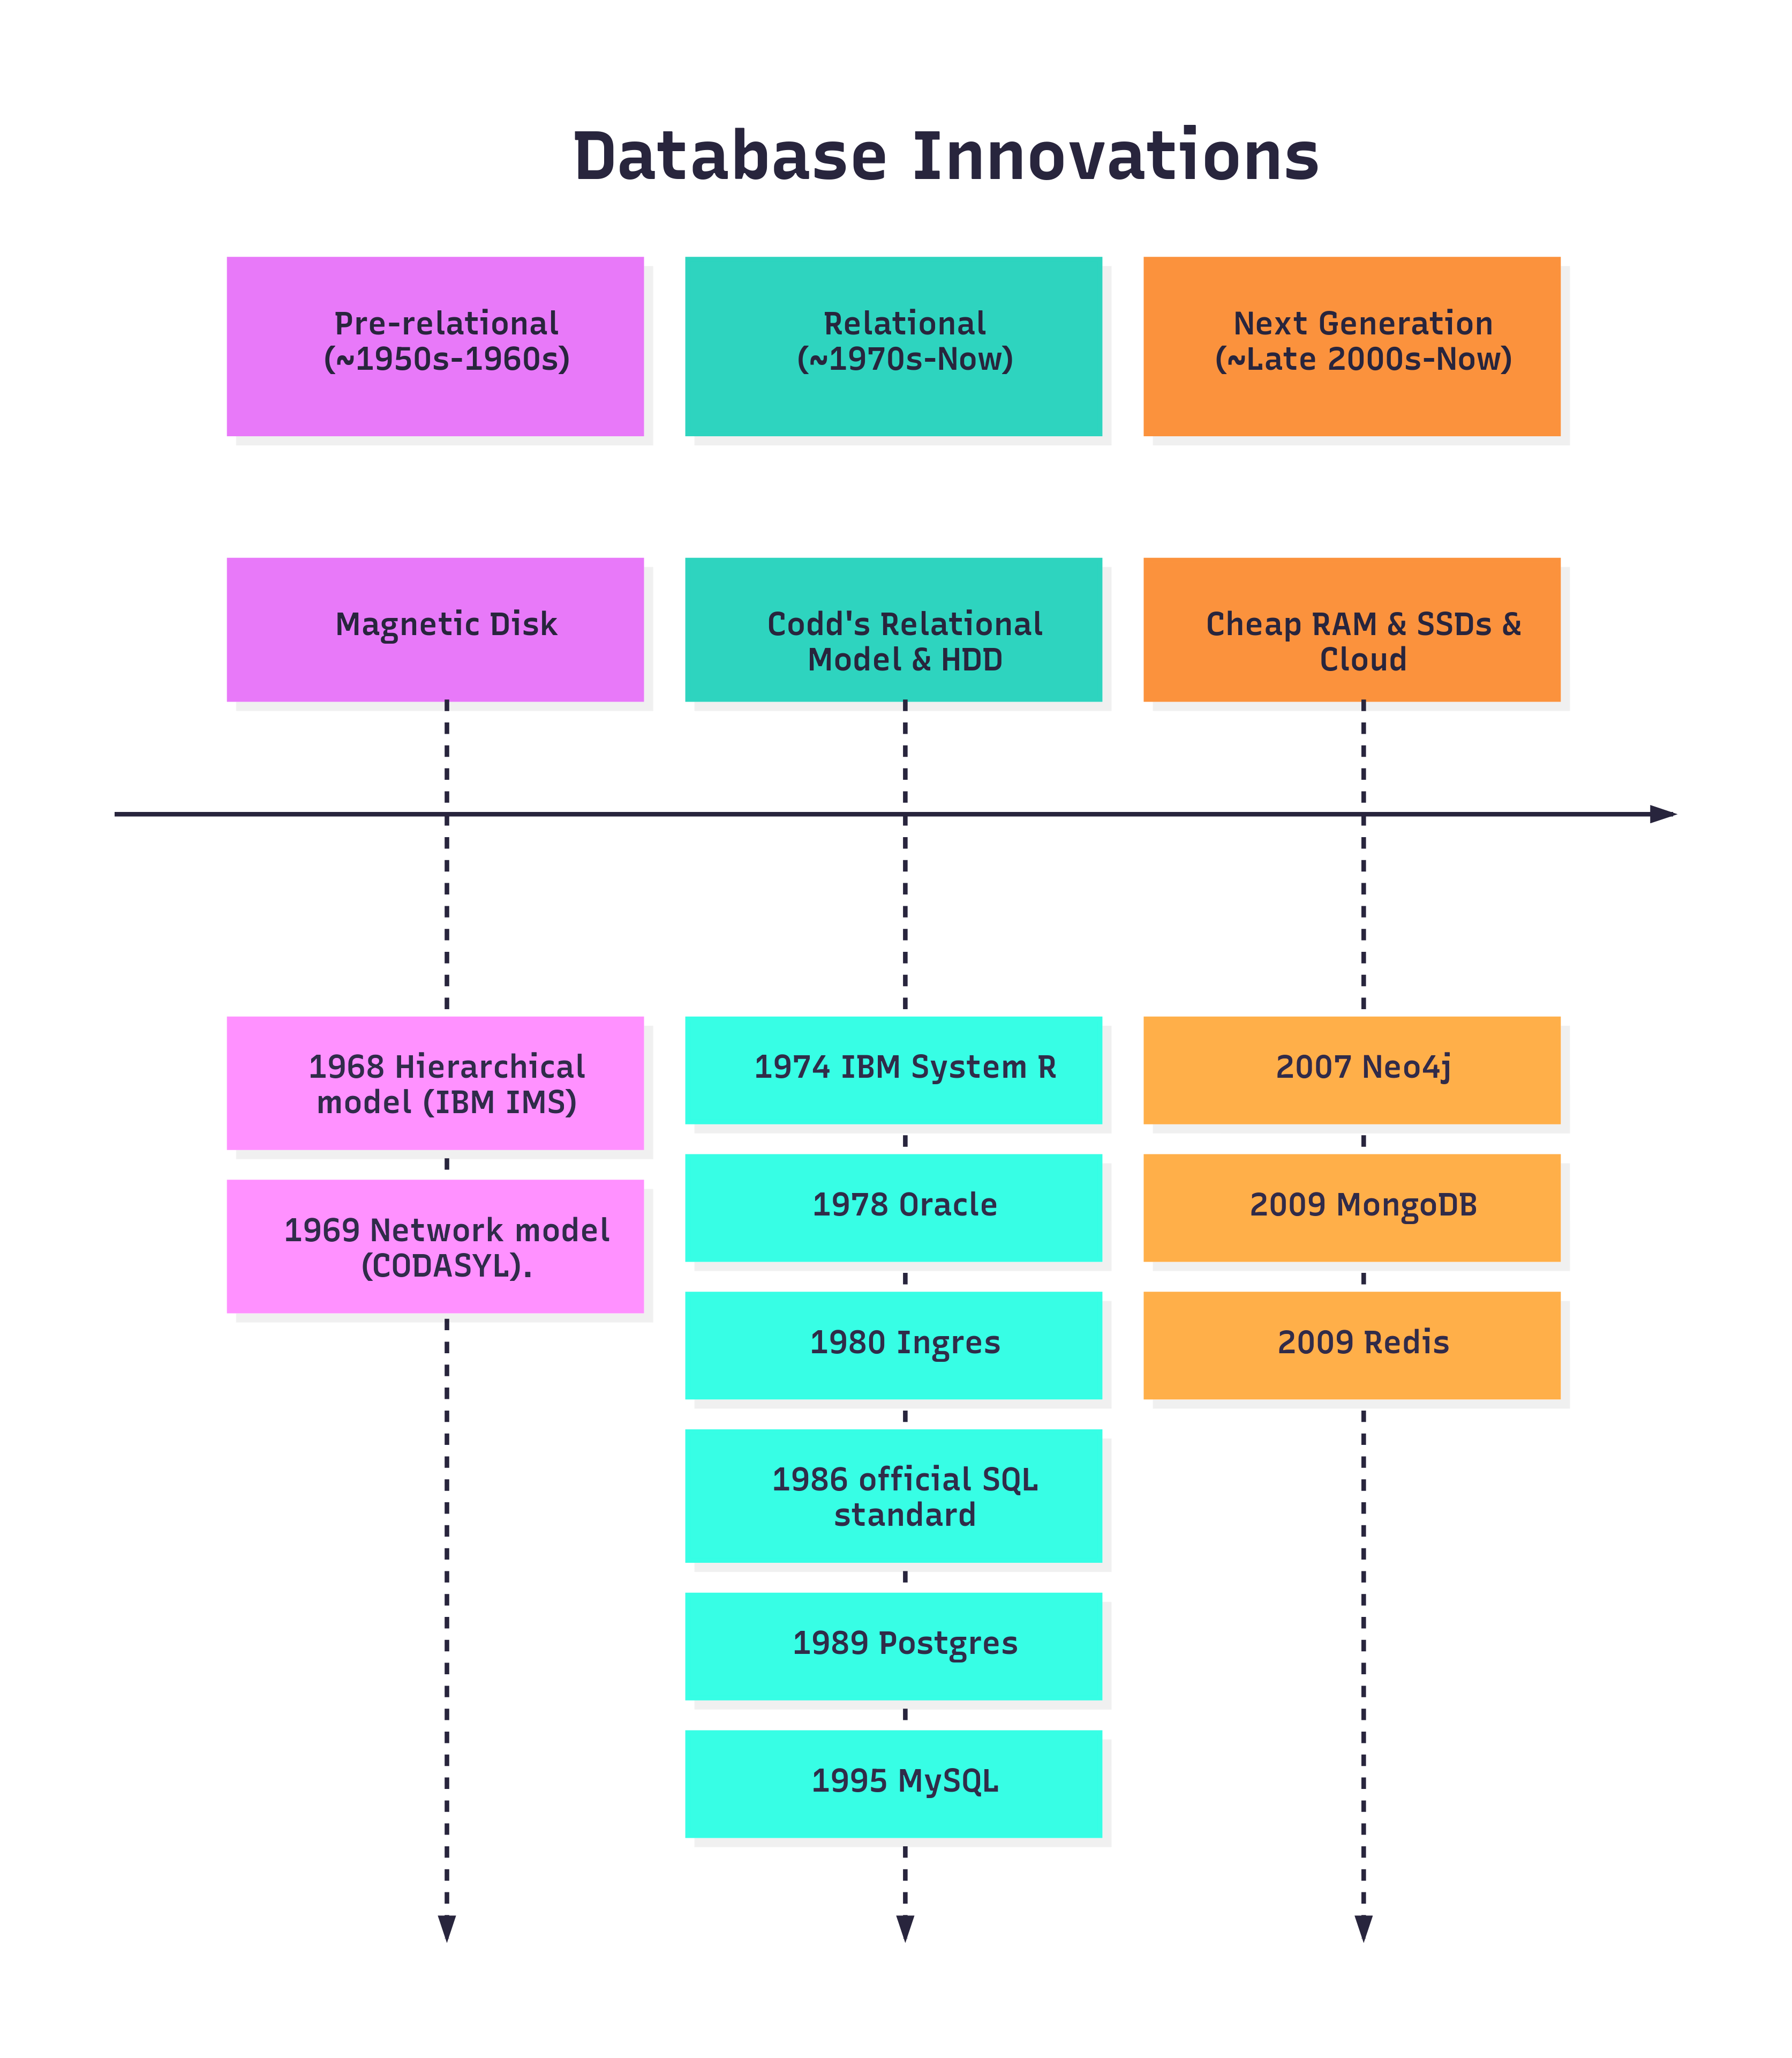
The evolution of databases has been driven by the application demand and the storage media.

Slide 8
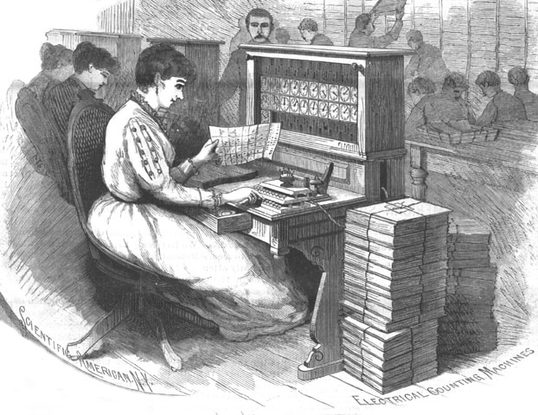
Illustration in "Scientific American" magazine, Aug. 30, 1890. Via reproduction at wikimedia
Punched Card and Herman Hollerith Machine
Notes:
Herman Hollerith funded a company called Tabulating Machine Company in. 1896. The company, along with other 3 companies, merged to a new company called ”Computing Tabulating Recording Company” in 1911. Then the company was renamed to International Business Machine, which is IBM.

Slide 9
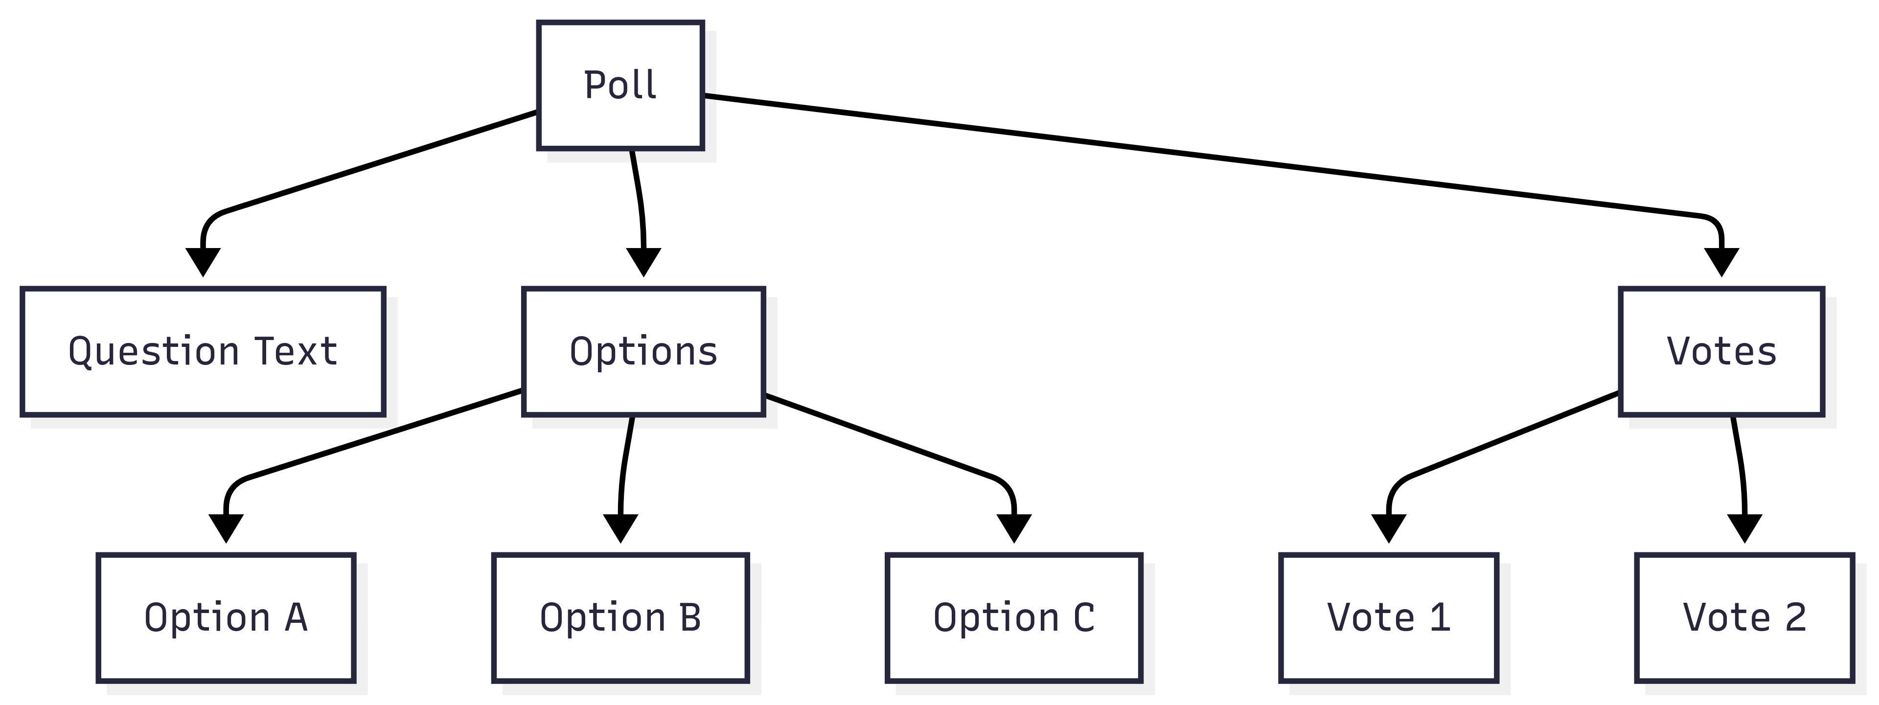
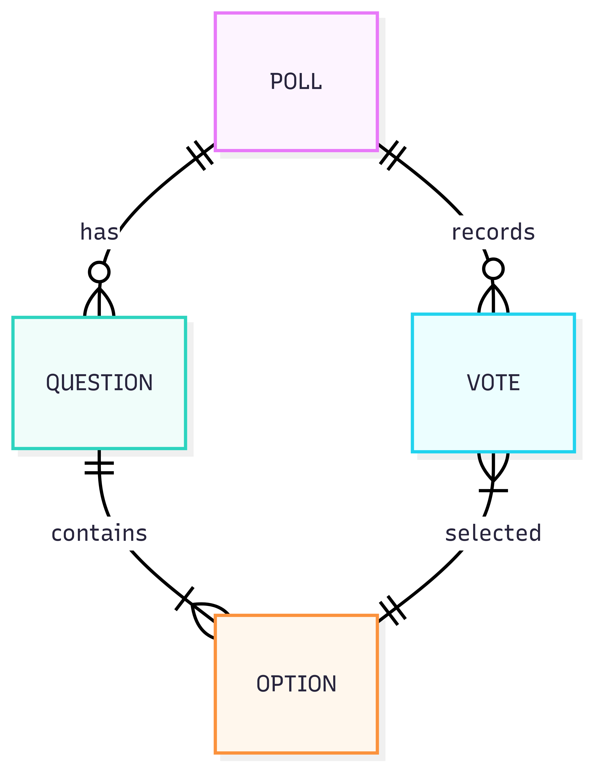
Hierarchical Model
Navigational
Data redundancy
Fixed schema
Structure query language (SQL)
Database Normalized
Relational Model
Network Model
Notes:
IBM innovated its first Hierarchical database in a contract with NASA, where NASA needs a database to track the rocket parts. Each record has strict partent and childs pointers. Around the same time, Network model came up, supporting more complex relationships. Enabling many-to-many mapping.
The schema is fixed.
this is literally rocket science

Slide 10
Hierarchical Database
Document Database
Data
Structure
- Fixed schema (e.g. fixed number of votes per person)
- Navigational
- Explicit pointers
- Flexible schema
- Direct querying
- Native Nesting
- Scalable
Features
FOR EACH poll IN PollRoot
IF NOT EXISTS(poll.Votes)
PRINT poll.id, poll.Question
ENDIF
ENDFOR
Example:
find polls
w/o vote
db.polls.find({ votes: { $eq: [] } })
Notes:
A document database looks similar to the pre-relational Hierarchical database. In stead of using the explicit pointers to program the relationship, the Document database supports the document (typically json) natively.
are they both NoSQL or ask students which is the new one or which is the new one?
25% final exam

Slide 11
Network Database
Graph Database
Data
Structure
- Fixed schema (e.g. fixed number of votes per person)
- Navigational
- Explicit pointers
- Flexible schema
- Direct querying
- Native Graph (Nodes and Edges)
- Scalable
Features
FOR EACH poll IN PollSet
IF FIRST VOTE IN PollHasVotes OF poll IS NULL
PRINT poll.ID, poll.Question
ENDIF
ENDFOR
Example:
find polls
w/o vote
MATCH (p:Poll)
WHERE NOT (p)-[:RECEIVED]->(:Vote)
RETURN p
Notes:
A document database looks similar to the pre-relational Hierarchical database. In stead of using the explicit pointers to program the relationship, the Document database supports the document (typically json) natively.

Slide 12
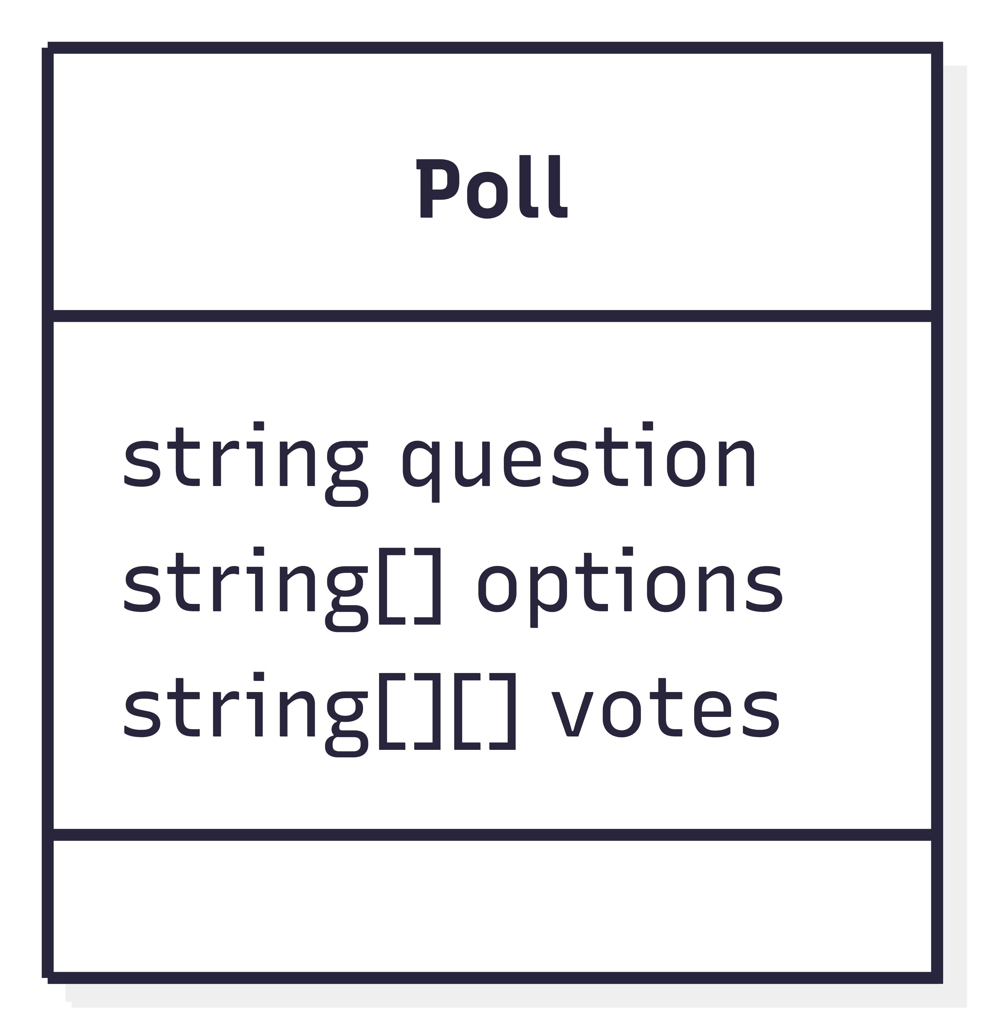
NoSQL: Key-Value Store and Wide-column
Key-value store
Wide column
Data
Structure
poll: id
(poll:id, poll_version)
- Very fast
- Single-key index
- Flexible Schema
- Scalable
- Very fast
- Multiple-key index
- Flexible Schema
- Scalable
Features
Example:
find polls
w/o vote
N/A
N/A
Use Case
Caching, session management
Internet of Things (IoT), Time sequence
Notes:
A document database looks similar to the pre-relational Hierarchical database. In stead of using the explicit pointers to program the relationship, the Document database supports the document (typically json) natively.

Slide 13
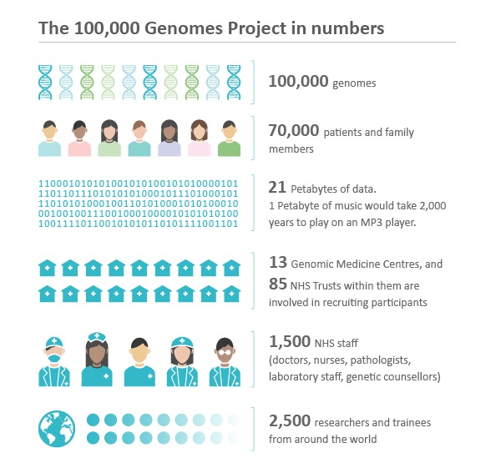

How would Document DB benefit BioScience?
100,000 Genomes Project and MongoDB
Patient data, genome data, sequencing metadata in 1 database
Horizontal scaling
Concurrent Read/Write
{
_id: "ENSG00000123456",
organism: "Homo sapiens”,
symbol: "TP53",
disease:[{name: "Li-Fraumeni syndrome”, …}]
sequence: "ATGCGATCGCATCGATCG…"
}
mongodb.com
https://github.com/uludag/nosql-biosets

Slide 14
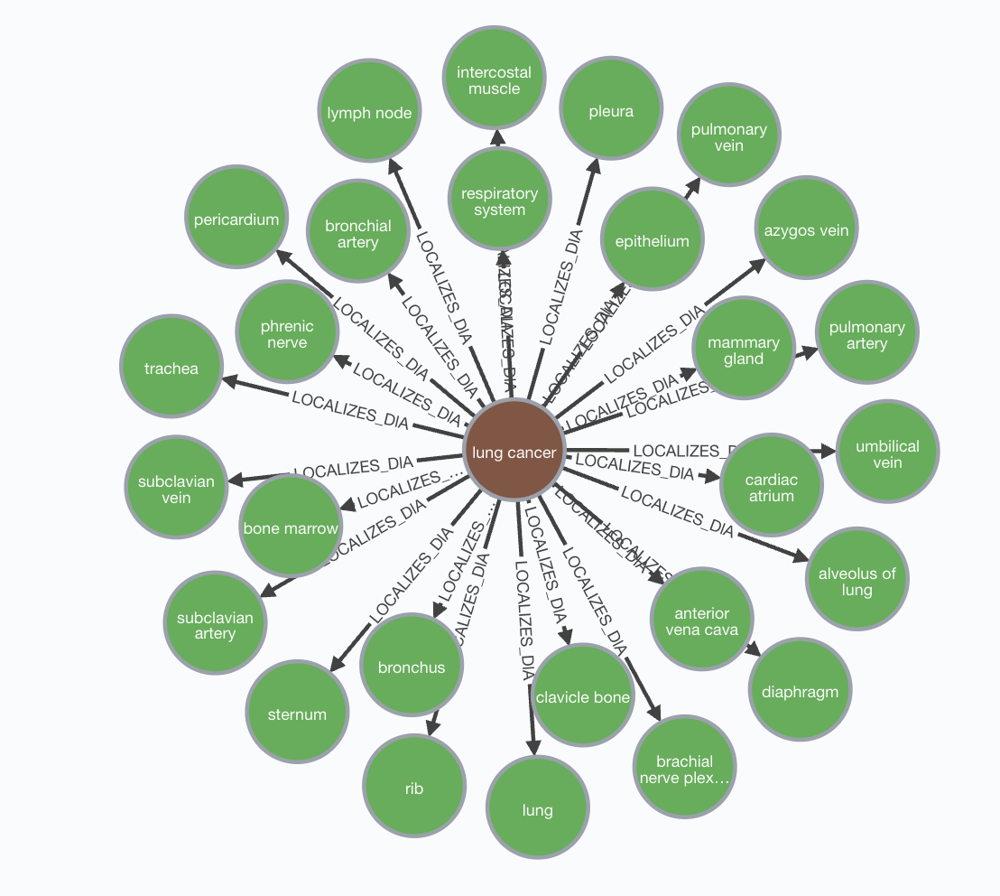
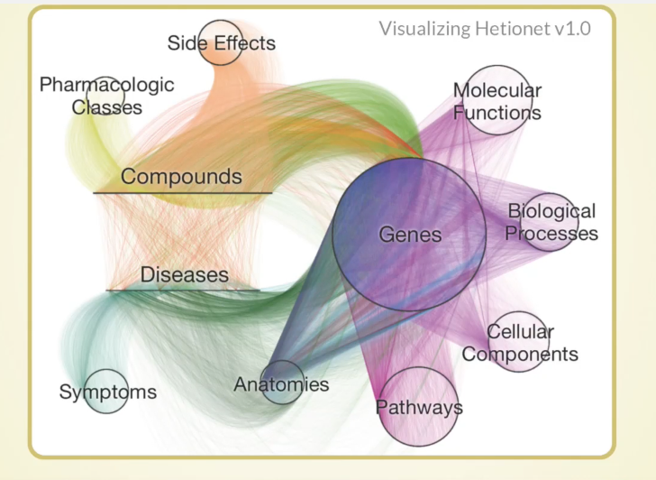
How would Graph DB benefit BioScience?
Which tissue does Lung Cancer Localize?
MATCH path = (:Disease {name: 'lung cancer'})-[:LOCALIZES_DlA]->()
RETURN path
neo4j.com
https://github.com/hetio/hetnetpy
Notes:
An interesting project called het

Slide 15
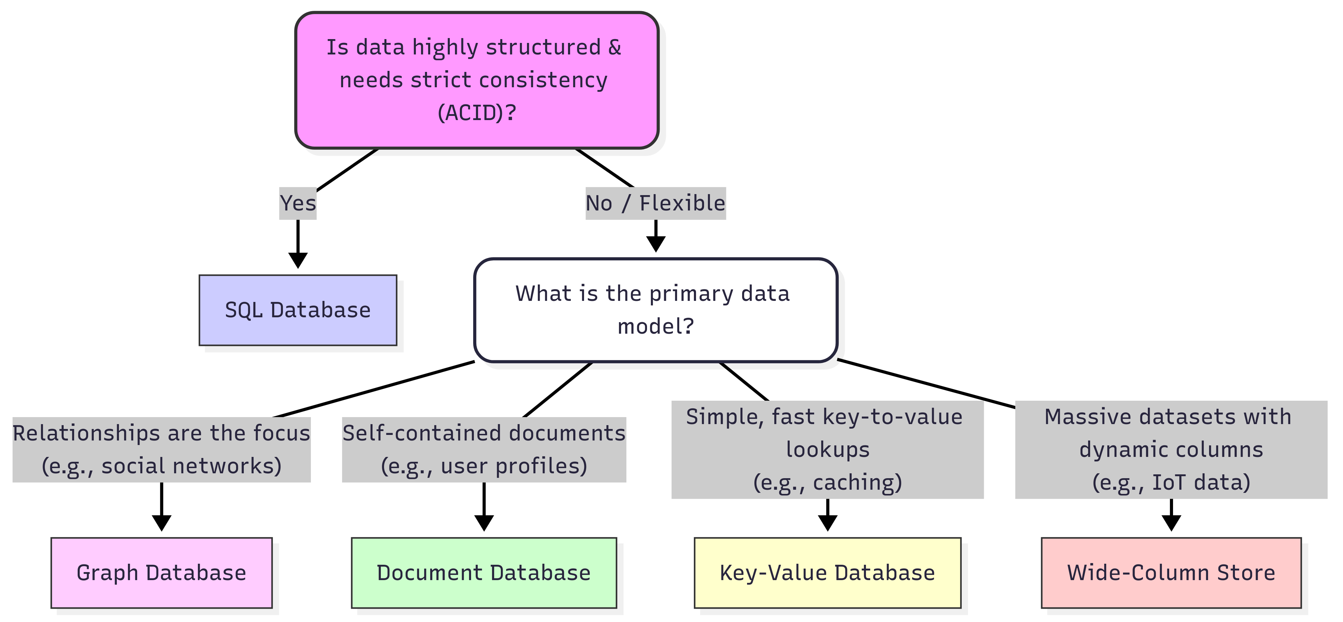
Which Database to choose?
Modern SQL databases now offer robust horizontal scaling, rivaling NoSQL systems. E.g. Google Spanner, MySQL NDB.
Notes:
ACID: Atomicity, Consistency, Isolation, and Durability
speak slower

Slide 16
What comes next: from concepts to hands-on
L25
MongoDB
L26
Graph basics
L27
Neo4j genomes
Document model
Nodes · relationships
65 genomes · KOs · tree
VCF variants as JSON documents
CRUD · RBAC · indexes
Aggregation ≈ bcftools stats
Property graph model
Cypher: MATCH MERGE
Traversal: shared neighbours
Model, import, explore
Q1: similar genomes
Q2: KO evolution on the tree
All hands-on sessions run on your laptop: Docker (MongoDB + Neo4j) + JupyterLab, no cloud account
NoSQL Databases for Bioinformatics · Lecture 24 · NoSQL foundations
16
Notes:
Today was about concepts: why NoSQL databases emerged, the four data models, and where they are used in the biosciences. The next three lectures turn the two models that matter most for bioinformatics into hands-on skills.
Lecture 25 (MongoDB, documents): we store genetic variants from a VCF file as documents, learn the CRUD operations, access control (RBAC), indexes and the aggregation framework, which does what bcftools stats does on the command line. Lecture 26 (graph basics): nodes, relationships, properties, and the Cypher query language, using this very course as the example, ending with a first look at genomic data as a graph. Lecture 27 (Neo4j): a real data set of 65 genomes annotated with KEGG Orthology (KO) gene functions and the tree of life: we find similar genomes and infer how KOs evolved.
All workshops run on your own laptop: MongoDB and Neo4j run in Docker containers and the notebooks in JupyterLab, so you need no cloud account and the materials keep working after the course. The next slide is your preparation checklist.

Slide 17
Get your laptop ready (before Lecture 25)
1
Install Docker
2
Get the materials and start the databases
3
Python environment and check
Docker Desktop (macOS, Windows) or Docker Engine + Compose (Linux)
Test: docker --version and docker compose version
git clone the course repository
cd docker && docker compose up -d
wait until docker compose ps says healthy
python3 -m venv .venv, activate it
pip install -r requirements.txt
python scripts/check_setup.py → 🎉
 | time | disk | internet
one-off preparation | 20–30 min | ≈ 4 GB | yes (downloads)
during the workshops |  |  | no: everything is local
Full guide + troubleshooting: SETUP.md in the repository
NoSQL Databases for Bioinformatics · Lecture 24 · NoSQL foundations
17
Notes:
Please do this before the hands-on sessions; it takes 20 to 30 minutes, mostly downloading, and about 4 GB of disk space. You need an internet connection only for this preparation; afterwards everything works offline.
Step 1: install Docker Desktop (macOS and Windows) or Docker Engine with the Compose plugin (Linux). Test it with docker --version and docker compose version. On a managed hospital laptop you may need your IT help desk for the installation. Step 2: get the course materials with git clone, and start the databases with docker compose up -d in the docker folder; the first start downloads about 1.5 GB of database images. Wait until docker compose ps says healthy. Step 3: create a Python virtual environment and install the packages with pip install -r requirements.txt, then run python scripts/check_setup.py: it tests Python, the packages, the data files and both databases and tells you how to fix anything that is wrong.
The full guide with Windows, macOS and Linux details and a troubleshooting table is SETUP.md in the repository. If your check fails, bring the output to the session.

Slide 18
Recap:
Evolution of database structures: pre-relational, SQL, to NoSQL
Data structures of Document, Graph, Key-value, and Wide-column
Decision tree of choosing the best databases for your project
Use of Document model and Graph model in BioScience projects

